Slide 1
CS-211 Data Structure & Algorithms
Lecture # 1
Abstract Data Types

Slide 2
Introduction
Data Structure
A data structure is a specialized format for organizing, processing, retrieving and storing data.
There are several basic and advanced types of data structures, all designed to arrange data to suit a specific purpose.
Linked List
Queues
Hash Tables
Trees
Data structures make it easy for users to access and work with the data they need in appropriate ways.
Most importantly, data structures frame the organization of information so that machines and humans can better understand it.

Slide 3
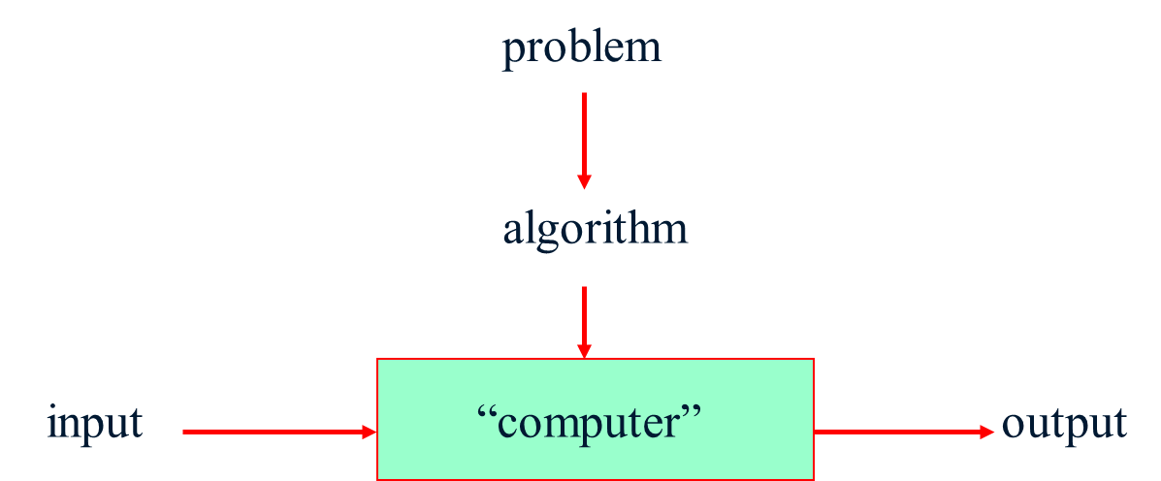
Introduction
Algorithms
An algorithm is a sequence of unambiguous instructions for solving a problem, i.e., for obtaining a required output for any legitimate input in a finite amount of time.

Slide 4
Introduction
Primitive Data Types - Programming languages commonly provide data types as part of the language itself. These data types, known as primitives.
The simple data types consist of values that are in the most basic form and cannot be decomposed into smaller parts. Integer and real types, for example, consist of single numeric values.
The complex data types, on the other hand, are constructed of multiple components consisting of simple types or other complex types. In Python, objects, strings, lists, and dictionaries, which can contain multiple values, are all examples of complex types.
The primitive types provided by a language may not be sufficient for solving large complex problems.
Thus, most languages allow for the construction of additional data types, known as user-defined types since they are defined by the programmer and not the language. Some of these data types can themselves be very complex.

Slide 5
Abstraction
An abstraction is a mechanism for separating the properties of an object and restricting the focus to those relevant in the current context.
The user of the abstraction does not have to understand all of the details in order to utilize the object, but only those relevant to the current task or problem.
Procedural abstraction is the use of a function or method knowing what it does but ignoring how it’s accomplished.
Data abstraction is the separation of the properties of a data type (its values and operations) from the implementation of that data type.

Slide 6
Abstract Data Types (ADT)
An abstract data type (or ADT) is a programmer-defined data type that species a set of data values and a collection of well-defined operations that can be performed on those values.

Slide 7
Abstract Data Types (ADT)
Constructors: Create and initialize new instances of the ADT.
Accessors: Return data contained in an instance without modifying it.
Mutators: Modify the contents of an ADT instance.
Iterators: Process individual data components sequentially.

Slide 8
General Definitions
A collection is a group of values with no implied organization or relationship between the individual values.
A container is any data structure or abstract data type that stores and organizes a collection.
A sequence is a container in which the elements are arranged in linear order from front to back, with each element accessible by position.
A sorted sequence is one in which the position of the elements is based on a prescribed relationship between each element and its successor.

Slide 9
Defining the ADT
A date represents a single day in the proleptic Gregorian calendar in which the first day starts on November 24, 4713 BC.
Date( month, day, year ): Creates a new Date instance initialized to the given Gregorian date which must be valid. Year 1 BC and earlier are indicated by negative year components.
day(): Returns the Gregorian day number of this date.
month(): Returns the Gregorian month number of this date.
year(): Returns the Gregorian year of this date.
monthName(): Returns the Gregorian month name of this date.
dayOfWeek(): Returns the day of the week as a number between 0 and 6 with 0 representing Monday and 6 representing Sunday.
numDays( otherDate ): Returns the number of days as a positive integer between this date and the otherDate.
isLeapYear(): Determines if this date falls in a leap year and returns the appropriate boolean value.
advanceBy( days ): Advances the date by the given number of days. The date is incremented if days is positive and decremented if days is negative. The date is capped to November 24, 4714 BC, if necessary.
comparable ( otherDate ): Compares this date to the otherDate to determine their logical ordering. This comparison can be done using any of the logical operators <, <=, >, >=, ==, !=.
toString (): Returns a string representing the Gregorian date in the format mm/dd/yyyy. Implemented as the Python operator that is automatically called via the str() constructor.

Slide 10
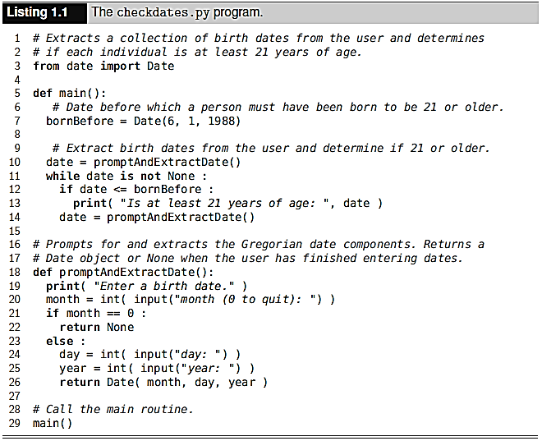
Using the ADT

Slide 11
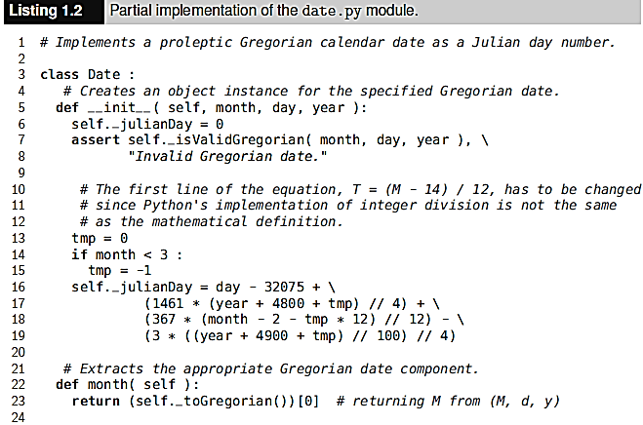
Implementing ADT

Slide 12
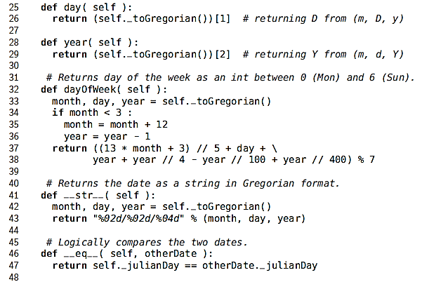
Implementing ADT

Slide 13
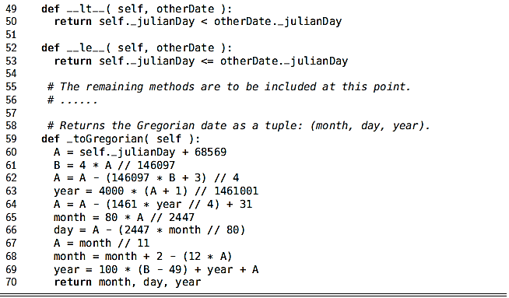
Implementing ADT

Slide 14
Complex ADT
Bags
A bag is a simple container like a shopping bag that can be used to store a collection of items.
The bag container restricts access to the individual items by only defining operations for adding and removing individual items, for determining if an item is in the bag, and for traversing over the collection of items.

Slide 15
Bags

Slide 16
Selecting a Data Structure
The implementation of a complex abstract data type typically requires the use of a data structure for organizing and managing the collection of data items.
We have to evaluate the suitability of a data structure for implementing a given abstract data type, which we base on the following criteria:
Does the data structure provide for the storage requirements as specified by the domain of the ADT?
Does the data structure provide the necessary data access and manipulation functionality to fully implement the ADT?
Does the data structure lend itself to an efficient implementation of the operations?

Slide 17
Bag ADT Implementation
To help verify a correct implementation of the Bag ADT using the list, we can outline how each bag operation will be implemented:
An empty bag can be represented by an empty list.
The size of the bag can be determined by the size of the list.
Determining if the bag contains a specific item can be done using the equivalent list operation.
When a new item is added to the bag, it can be appended to the end of the list since there is no specific ordering of the items in a bag.
Removing an item from the bag can also be handled by the equivalent list operation.
The items in a list can be traversed using a for loop and Python provides for user-defined iterators that be used with a bag.

Slide 19
Iterators
An iterator is an object that provides a mechanism for performing generic traversals through a container without having to expose the underlying implementation.
To use Python's traversal mechanism with our own abstract data types, we must define an iterator class, which is a class in Python containing two special methods, __iter__ and __next__ . Iterator classes are commonly defined in the same module as the corresponding container class.

Slide 20
Iterators

Slide 21
Application: Student Records

Slide 22
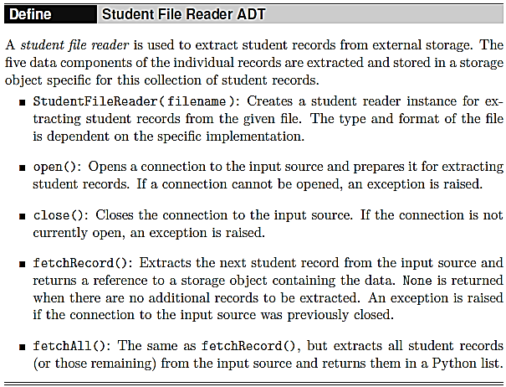
Application: Student File Reader ADT

Slide 23
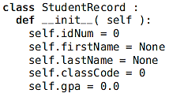
Application: Student File Reader ADT - Implementation

Slide 24
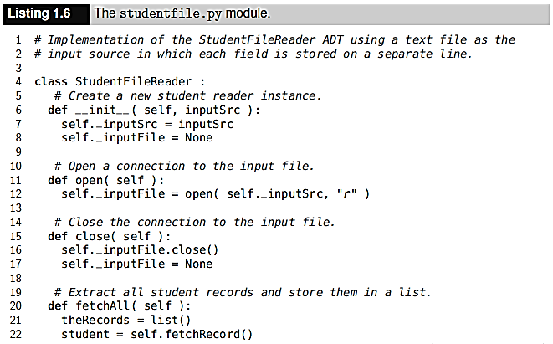
Application: Student File Reader ADT - Implementation

Slide 25
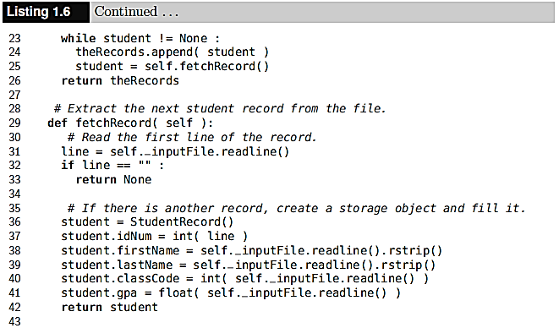
Application: Student File Reader ADT - Implementation

Slide 26
Application: Student File Reader ADT - Implementation

